Slide 1
SMV Outlet Fixed Blockage Comparison

Slide 2
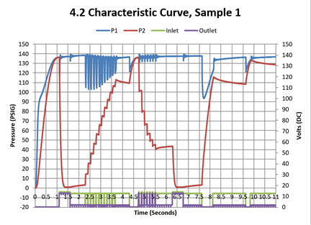
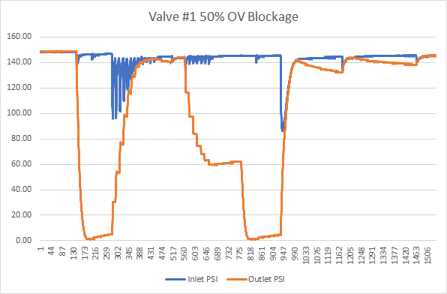
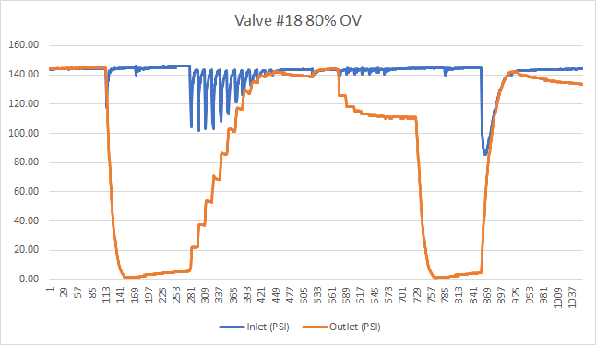
Fixed Blockage - Outlet
Control, 0% OV Blockage

Slide 3
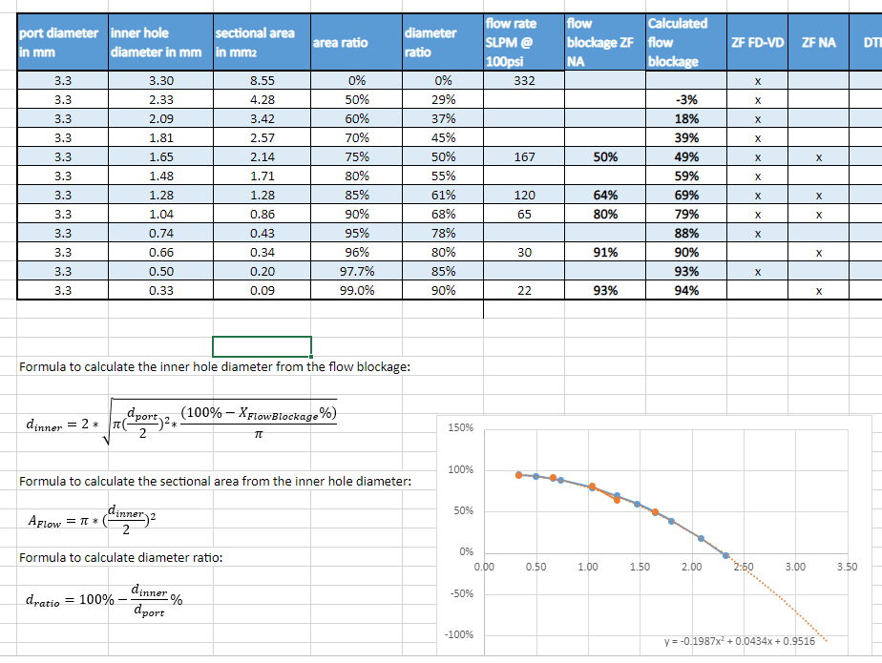
Blockage Matrix

